Slide 1

Assignment 1: Analyzing the Superstore
Summer MGMT 59000: AI-Assisted Big Data Analytics in the Cloud
Group: Data Ninjas 3
July 2025
Fazecas, James
Wang, Yuxiao
Williams, Kyasha
Yudanin, Michael
Zaharakis, Dino

Slide 2
Problem Statement
Executive Summary
To improve business performance and guide smarter decisions, the organization will take a closer look at how sales, customer habits, product outcomes, and regional operations influence growth. It will study sales trends over time to identify revenue drivers and seasonal peaks. At the same time, it will analyze customer segments, purchasing behaviors, and loyalty factors. The business will also review product and category performance, pinpoint profitability levers, and assess pricing impacts. Finally, it will evaluate regional performance and operational efficiency to uncover areas that support or hinder success; sharpening strategic focus for future growth.
Notes:
https://www.indeed.com/career-advice/career-development/how-to-measure-business-performance
https://www.grammarly.com/blog/business-writing/problem-statement/#:~:text=What%20is%20a%20problem%20statement,project%20or%20proposal%20is%20necessary.

Slide 3

Sales & Revenue Analyst
Michael Yudanin
Focus Questions:
What drives sales performance across different dimensions?
Which factors most impact revenue generation?
Where are the growth opportunities?
Analysis:
Sales trends over time with seasonality
Revenue drivers and correlations
Predictive factors for high-sales periods

Slide 4
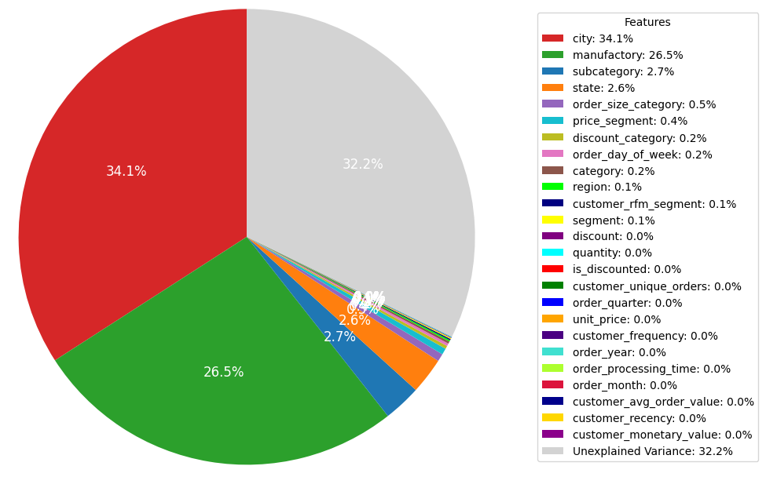
Factors driving sales performance
Linear Regression analysis shows two factors impacting sales:
City
Manufacture

Slide 5
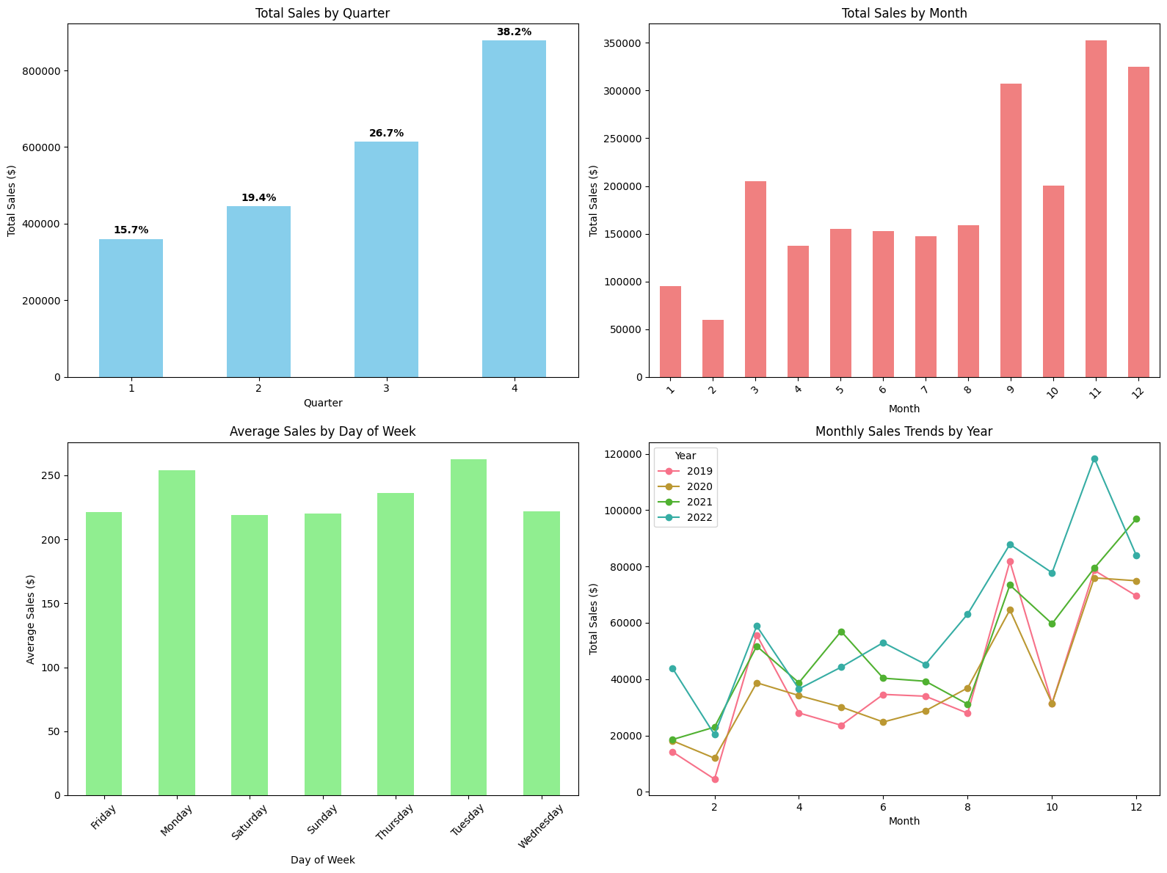
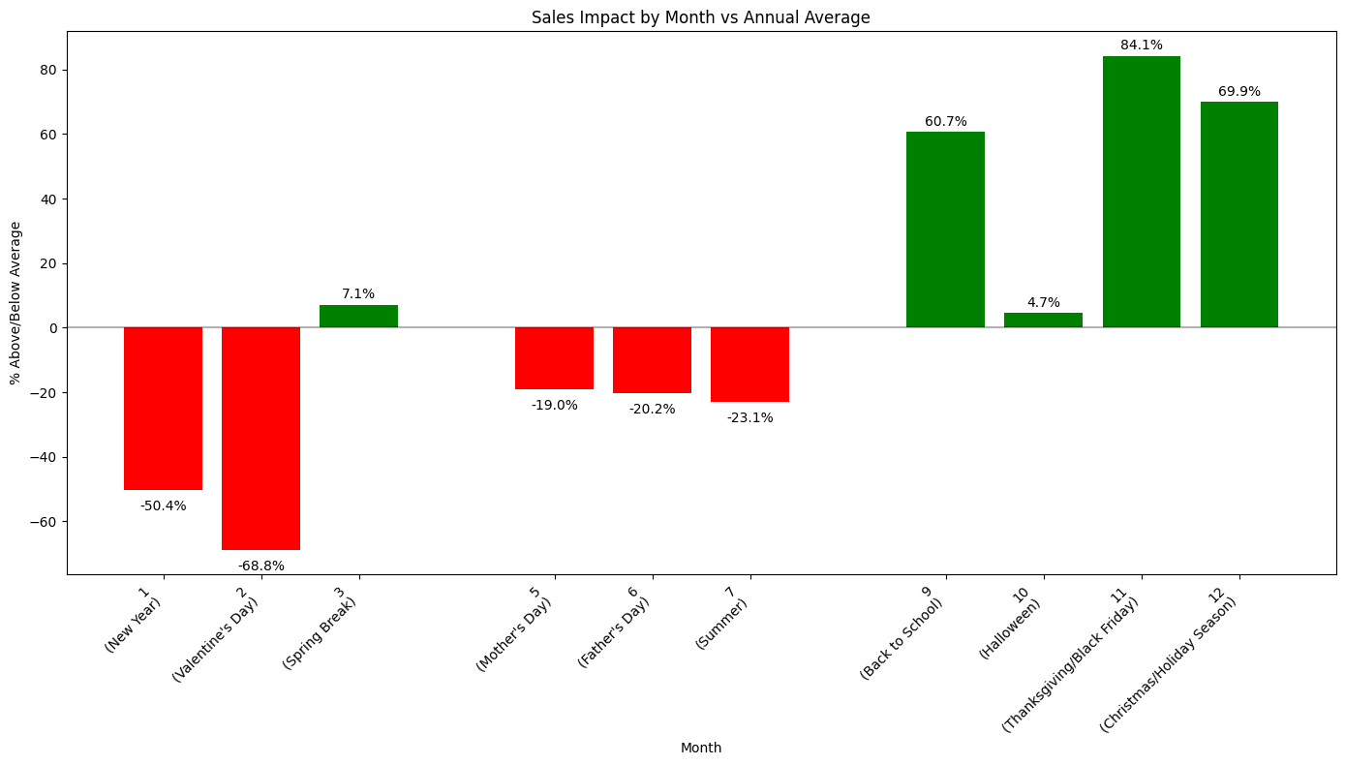
Seasonality
Q4 brings more sales
The trend persists over the years
The difference is not significant at the <0.05 level (p=0.073308)
Further research is recommended

Slide 6
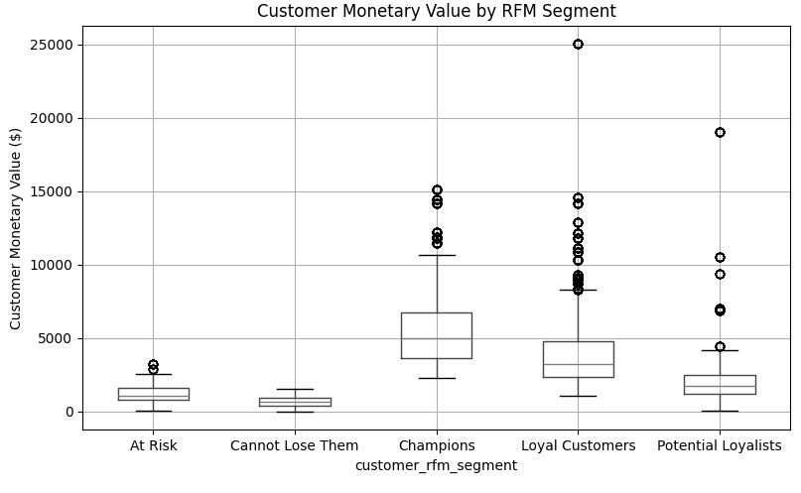
Champion customers contribute more

Slide 7
Growth opportunities
Leverage Sales Trends - Utilize the identified sales peaks
November, December, March are sales peaks
Despite non-significant results, acting on this will not hurt
Focus strategic marketing campaigns and inventory management for Q4.
Target High-Value Customers and Regions
Focus sales and marketing efforts on the 'Consumer' segment and regions like the 'West' and 'East' which show strong sales performance.
Focus on high-value Cities
City has an important impact on sales and profits.
Focus on high-value cities to tap into additional potential.
Focus on high-value Products:
Manufactury has an important impact on sales and profits.
Optimize procurement and focus on high-value products.

Slide 8

Customer Behavior Analyst
Yuxiao Wang
Focus Questions:
Who are our most valuable customers?
What patterns exist in customer purchasing?
How can we improve customer retention?
Analysis:
Customer segmentation and profiling
Purchase pattern analysis
Customer lifetime value indicators

Slide 9
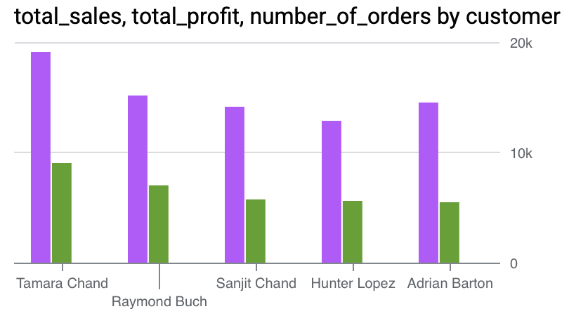
Customer Behavior Analyst
MVP (Most Value Prospect)

Slide 10
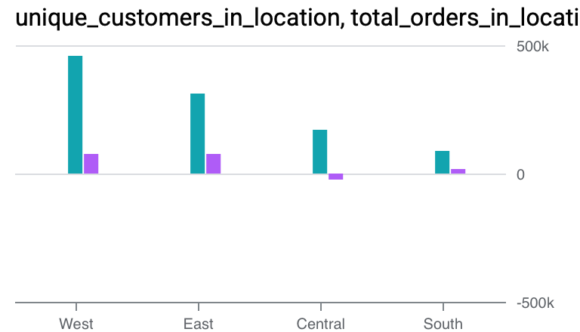
Customer Behavior Analyst
Customer Segmentation

Slide 11
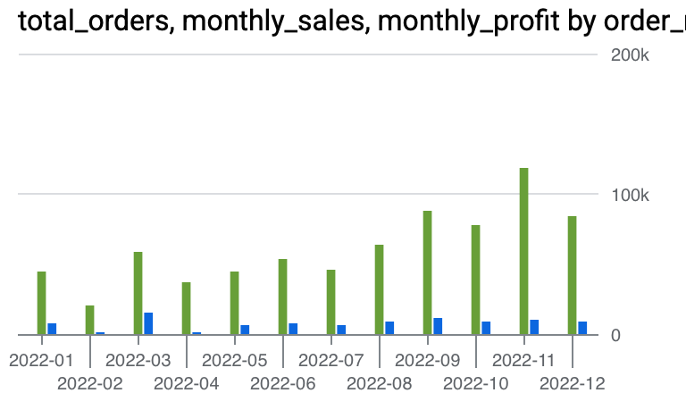
Customer Behavior Analyst
Seasonal pattern

Slide 12

Regional/Operational Analyst
Kyasha Williams
Member D: Regional/Operational Analyst
Focus Questions:
How does performance vary by location?
What operational factors impact success?
Where should we expand or consolidate?
Analysis:
Regional performance metrics
Shipping and operational efficiency
Market opportunity identification
Notes:
Synthesis of Performance by Location, Operational Success, and Expansion/Consolidation
Based on the comprehensive analysis of the Superstore dataset focusing on regional performance, operational factors, and market opportunities, we can now synthesize the findings to answer the key focus questions:
How does performance vary by location?
Performance varies significantly by location, both at the regional and state levels:
Regional Variation: The West and East regions are the top performers in terms of both total sales and total profit. The South and Central regions lag behind, with the Central region having the lowest total profit. This indicates a strong geographic disparity in overall business success.
State-Level Variation: Within regions, there is also considerable variation in performance. Some states within the South and Central regions show positive profit margins and decent sales, suggesting pockets of opportunity even within lower-performing regions. Conversely, some states in otherwise high-performing regions might have lower profitability, possibly due to localized factors.
Profitability Variation: Average profit margin also varies by region, with the West having the highest average profit margin, and the Central region having a negative average profit margin. This highlights that not only sales volume but also profitability per sale differs geographically.
What operational factors impact success?
Based on the analyses performed:
Shipping Time: The direct impact of shipping time on overall profit margin and discount levels was not strongly evident in this analysis. This suggests that while shipping efficiency is important for customer satisfaction, in this dataset, it doesn't appear to be a primary direct driver of profitability or a systematic reason for applying discounts. Other operational costs (e.g., warehousing, returns, supply chain efficiency not directly measured by shipping time) could still play a significant role in regional profit variations, particularly in the Central region.
Product Mix and Profitability: The profitability varies significantly by product category and sub-category. Regions or states that sell a higher proportion of high-profit-margin products (like certain Office Supplies and Technology items) are likely to have better overall profit performance. Conversely, regions with a higher proportion of sales in low-profit or negative-profit sub-categories (like some Furniture and Office Supplies) will see their overall profitability negatively impacted.
Discounting Strategies: The analysis showed a clear negative relationship between discount levels and profit margins. Regions or product categories where aggressive discounting is more prevalent will likely experience lower profitability.
Where should we expand or consolidate?
Based on the regional performance, profitability analysis, and market opportunity identification:
Expand in High-Performing Areas: Expansion efforts should prioritize the West and East regions, capitalizing on their existing strong performance. This could involve increasing market penetration, expanding product offerings in successful categories within these regions, or optimizing infrastructure to support further growth. Specific high-performing states within other regions also represent potential expansion targets.
Investigate and Improve in Lower-Performing Areas: The South and Central regions require careful investigation. Rather than immediate consolidation, the focus should be on understanding the root causes of lower sales and profitability. This involves analyzing costs, reviewing pricing and discounting strategies, evaluating the competitive landscape, and assessing the product mix in these regions.
Consider Consolidation in Specific Low-Profit Pockets: Consolidation might be considered in specific states or areas within the South and Central regions that consistently show very low sales and significant negative profit margins across multiple product categories, and where efforts to improve performance have not been successful.
Re-evaluate Low-Profit Categories/Sub-Categories: Regardless of the region, sub-categories with persistently low or negative profit margins should be re-evaluated. This could involve optimizing operations related to these products, adjusting pricing, reducing inventory, or potentially phasing them out if they are consistently unprofitable and do not serve a strategic purpose (e.g., driving traffic).
In summary, performance varies significantly by location, influenced by a combination of regional economic factors, customer demographics, product mix, and discounting strategies. While shipping time's direct impact wasn't strongly evident, other operational costs and efficiencies likely play a role in regional profitability. Strategic expansion should focus on high-performing regions and specific high-profit states, while lower-performing areas require targeted investigation and improvement before considering consolidation. Addressing low-profitability in specific product categories is also crucial for overall business success.
Synthesis of Regional Performance, Shipping Impact, and Market Opportunities
This synthesis integrates the findings from the analyses of regional performance, the impact of shipping time, and the identification of market opportunities (expansion and consolidation) in the Superstore dataset.
1. Regional Performance:
The analysis of regional sales and profit clearly shows a significant disparity in performance across the four regions. The West and East regions are the strongest performers in terms of both total sales and total profit, highlighting their crucial role in the Superstore's overall success. The South and especially the Central region lag significantly in both metrics, with the Central region exhibiting the lowest total profit. This strong geographic variation underscores the importance of tailoring strategies to specific regional markets.
2. Shipping Time and its Impact:
The investigation into the impact of shipping time on profitability and potential customer satisfaction (inferred through discounts) did not reveal a strong direct correlation in this dataset. The scatter plots showed that profit margins and discount levels are distributed across various shipping times, suggesting that while efficient shipping is important for overall operations and customer experience, the duration of shipping alone, as analyzed here, is not a primary determinant of individual transaction profitability or discount application. Other operational factors and costs within regions or related to specific products are likely more influential on profitability.
3. Market Opportunities: Expansion and Consolidation:
Based on the regional performance and profitability analysis (including insights into category performance within regions), potential areas for expansion and consolidation can be identified:
Expansion Opportunities: The strong performance in the West and East regions indicates these are prime areas for expansion, focusing on increasing market penetration and investing further in successful product categories within these regions. Additionally, identifying and targeting specific high-performing states within the South and Central regions could offer localized expansion opportunities.
Consolidation or Improvement Areas: The lower performance in the South and Central regions, particularly the Central region's low profit, suggests these areas require careful evaluation. Rather than immediate consolidation, the focus should be on understanding the underlying reasons for lower sales and profitability through a detailed analysis of costs, pricing, product mix, and competition within these regions. Consolidation might be a consideration for specific low-profit pockets within these regions if improvement efforts are unsuccessful. Furthermore, consistently low-profit sub-categories across all regions should be re-evaluated for potential optimization or consolidation.
Overall Conclusion:
The Superstore's performance is heavily influenced by regional factors, with the West and East regions driving the majority of sales and profit. While the direct impact of shipping duration on profitability and discounts is not clearly evident, other operational efficiencies and costs likely contribute to regional performance variations. Strategic decisions regarding expansion should prioritize high-performing regions, while lower-performing areas require thorough investigation and targeted improvement strategies before considering consolidation. Addressing the profitability of specific product categories and sub-categories, especially those with negative margins, is crucial across all locations.

Slide 13
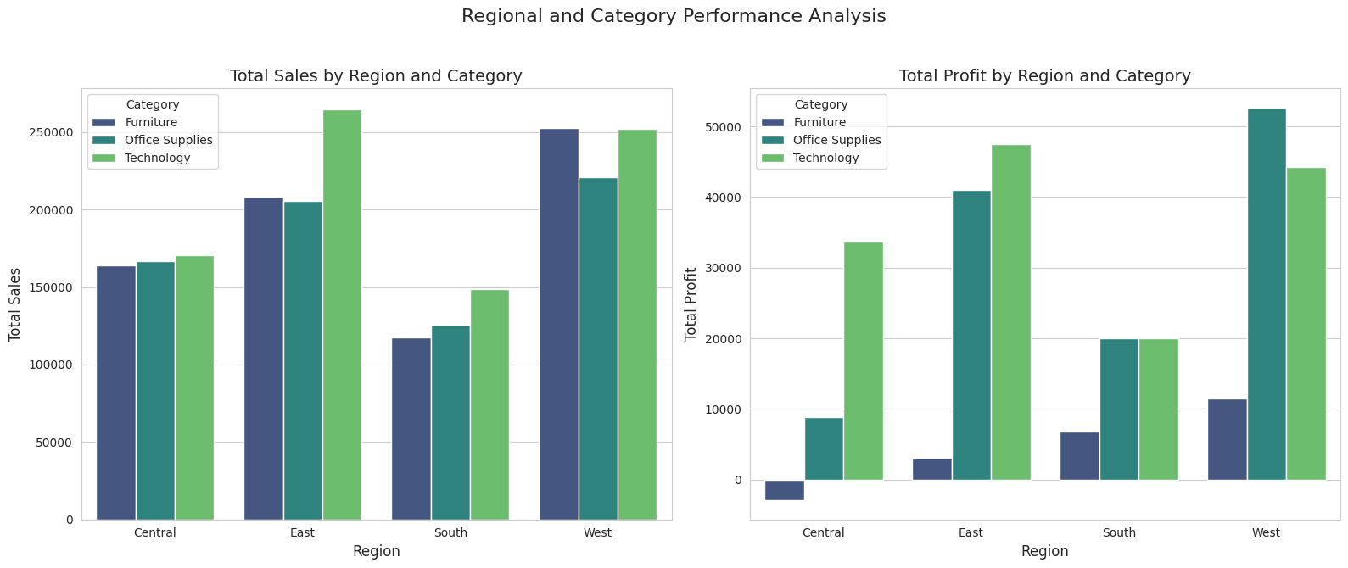
Regional/Operational Analyst
Kyasha Williams
Regional Performance Metrics
Notes:
Synthesis of Performance by Location, Operational Success, and Expansion/Consolidation
Based on the comprehensive analysis of the Superstore dataset focusing on regional performance, operational factors, and market opportunities, we can now synthesize the findings to answer the key focus questions:
How does performance vary by location?
Performance varies significantly by location, both at the regional and state levels:
Regional Variation: The West and East regions are the top performers in terms of both total sales and total profit. The South and Central regions lag behind, with the Central region having the lowest total profit. This indicates a strong geographic disparity in overall business success.
State-Level Variation: Within regions, there is also considerable variation in performance. Some states within the South and Central regions show positive profit margins and decent sales, suggesting pockets of opportunity even within lower-performing regions. Conversely, some states in otherwise high-performing regions might have lower profitability, possibly due to localized factors.
Profitability Variation: Average profit margin also varies by region, with the West having the highest average profit margin, and the Central region having a negative average profit margin. This highlights that not only sales volume but also profitability per sale differs geographically.
What operational factors impact success?
Based on the analyses performed:
Shipping Time: The direct impact of shipping time on overall profit margin and discount levels was not strongly evident in this analysis. This suggests that while shipping efficiency is important for customer satisfaction, in this dataset, it doesn't appear to be a primary direct driver of profitability or a systematic reason for applying discounts. Other operational costs (e.g., warehousing, returns, supply chain efficiency not directly measured by shipping time) could still play a significant role in regional profit variations, particularly in the Central region.
Product Mix and Profitability: The profitability varies significantly by product category and sub-category. Regions or states that sell a higher proportion of high-profit-margin products (like certain Office Supplies and Technology items) are likely to have better overall profit performance. Conversely, regions with a higher proportion of sales in low-profit or negative-profit sub-categories (like some Furniture and Office Supplies) will see their overall profitability negatively impacted.
Discounting Strategies: The analysis showed a clear negative relationship between discount levels and profit margins. Regions or product categories where aggressive discounting is more prevalent will likely experience lower profitability.
Where should we expand or consolidate?
Based on the regional performance, profitability analysis, and market opportunity identification:
Expand in High-Performing Areas: Expansion efforts should prioritize the West and East regions, capitalizing on their existing strong performance. This could involve increasing market penetration, expanding product offerings in successful categories within these regions, or optimizing infrastructure to support further growth. Specific high-performing states within other regions also represent potential expansion targets.
Investigate and Improve in Lower-Performing Areas: The South and Central regions require careful investigation. Rather than immediate consolidation, the focus should be on understanding the root causes of lower sales and profitability. This involves analyzing costs, reviewing pricing and discounting strategies, evaluating the competitive landscape, and assessing the product mix in these regions.
Consider Consolidation in Specific Low-Profit Pockets: Consolidation might be considered in specific states or areas within the South and Central regions that consistently show very low sales and significant negative profit margins across multiple product categories, and where efforts to improve performance have not been successful.
Re-evaluate Low-Profit Categories/Sub-Categories: Regardless of the region, sub-categories with persistently low or negative profit margins should be re-evaluated. This could involve optimizing operations related to these products, adjusting pricing, reducing inventory, or potentially phasing them out if they are consistently unprofitable and do not serve a strategic purpose (e.g., driving traffic).
In summary, performance varies significantly by location, influenced by a combination of regional economic factors, customer demographics, product mix, and discounting strategies. While shipping time's direct impact wasn't strongly evident, other operational costs and efficiencies likely play a role in regional profitability. Strategic expansion should focus on high-performing regions and specific high-profit states, while lower-performing areas require targeted investigation and improvement before considering consolidation. Addressing low-profitability in specific product categories is also crucial for overall business success.
Synthesis of Regional Performance, Shipping Impact, and Market Opportunities
This synthesis integrates the findings from the analyses of regional performance, the impact of shipping time, and the identification of market opportunities (expansion and consolidation) in the Superstore dataset.
1. Regional Performance:
The analysis of regional sales and profit clearly shows a significant disparity in performance across the four regions. The West and East regions are the strongest performers in terms of both total sales and total profit, highlighting their crucial role in the Superstore's overall success. The South and especially the Central region lag significantly in both metrics, with the Central region exhibiting the lowest total profit. This strong geographic variation underscores the importance of tailoring strategies to specific regional markets.
2. Shipping Time and its Impact:
The investigation into the impact of shipping time on profitability and potential customer satisfaction (inferred through discounts) did not reveal a strong direct correlation in this dataset. The scatter plots showed that profit margins and discount levels are distributed across various shipping times, suggesting that while efficient shipping is important for overall operations and customer experience, the duration of shipping alone, as analyzed here, is not a primary determinant of individual transaction profitability or discount application. Other operational factors and costs within regions or related to specific products are likely more influential on profitability.
3. Market Opportunities: Expansion and Consolidation:
Based on the regional performance and profitability analysis (including insights into category performance within regions), potential areas for expansion and consolidation can be identified:
Expansion Opportunities: The strong performance in the West and East regions indicates these are prime areas for expansion, focusing on increasing market penetration and investing further in successful product categories within these regions. Additionally, identifying and targeting specific high-performing states within the South and Central regions could offer localized expansion opportunities.
Consolidation or Improvement Areas: The lower performance in the South and Central regions, particularly the Central region's low profit, suggests these areas require careful evaluation. Rather than immediate consolidation, the focus should be on understanding the underlying reasons for lower sales and profitability through a detailed analysis of costs, pricing, product mix, and competition within these regions. Consolidation might be a consideration for specific low-profit pockets within these regions if improvement efforts are unsuccessful. Furthermore, consistently low-profit sub-categories across all regions should be re-evaluated for potential optimization or consolidation.
Overall Conclusion:
The Superstore's performance is heavily influenced by regional factors, with the West and East regions driving the majority of sales and profit. While the direct impact of shipping duration on profitability and discounts is not clearly evident, other operational efficiencies and costs likely contribute to regional performance variations. Strategic decisions regarding expansion should prioritize high-performing regions, while lower-performing areas require thorough investigation and targeted improvement strategies before considering consolidation. Addressing the profitability of specific product categories and sub-categories, especially those with negative margins, is crucial across all locations.

Slide 14
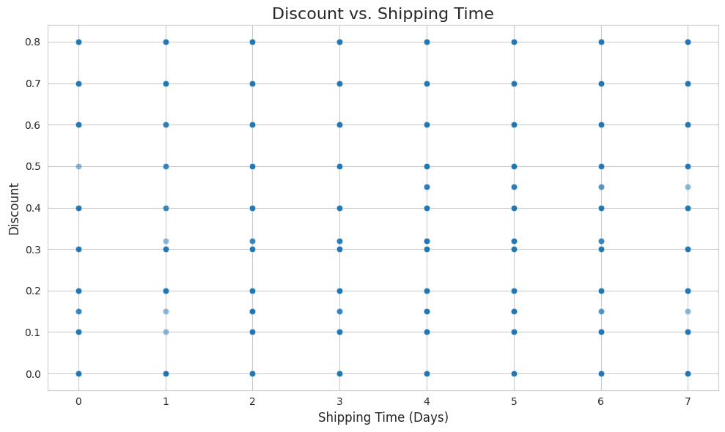
Regional/Operational Analyst
Kyasha Williams
Shipping and Operational Efficiency
Notes:
Synthesis of Performance by Location, Operational Success, and Expansion/Consolidation
Based on the comprehensive analysis of the Superstore dataset focusing on regional performance, operational factors, and market opportunities, we can now synthesize the findings to answer the key focus questions:
How does performance vary by location?
Performance varies significantly by location, both at the regional and state levels:
Regional Variation: The West and East regions are the top performers in terms of both total sales and total profit. The South and Central regions lag behind, with the Central region having the lowest total profit. This indicates a strong geographic disparity in overall business success.
State-Level Variation: Within regions, there is also considerable variation in performance. Some states within the South and Central regions show positive profit margins and decent sales, suggesting pockets of opportunity even within lower-performing regions. Conversely, some states in otherwise high-performing regions might have lower profitability, possibly due to localized factors.
Profitability Variation: Average profit margin also varies by region, with the West having the highest average profit margin, and the Central region having a negative average profit margin. This highlights that not only sales volume but also profitability per sale differs geographically.
What operational factors impact success?
Based on the analyses performed:
Shipping Time: The direct impact of shipping time on overall profit margin and discount levels was not strongly evident in this analysis. This suggests that while shipping efficiency is important for customer satisfaction, in this dataset, it doesn't appear to be a primary direct driver of profitability or a systematic reason for applying discounts. Other operational costs (e.g., warehousing, returns, supply chain efficiency not directly measured by shipping time) could still play a significant role in regional profit variations, particularly in the Central region.
Product Mix and Profitability: The profitability varies significantly by product category and sub-category. Regions or states that sell a higher proportion of high-profit-margin products (like certain Office Supplies and Technology items) are likely to have better overall profit performance. Conversely, regions with a higher proportion of sales in low-profit or negative-profit sub-categories (like some Furniture and Office Supplies) will see their overall profitability negatively impacted.
Discounting Strategies: The analysis showed a clear negative relationship between discount levels and profit margins. Regions or product categories where aggressive discounting is more prevalent will likely experience lower profitability.
Where should we expand or consolidate?
Based on the regional performance, profitability analysis, and market opportunity identification:
Expand in High-Performing Areas: Expansion efforts should prioritize the West and East regions, capitalizing on their existing strong performance. This could involve increasing market penetration, expanding product offerings in successful categories within these regions, or optimizing infrastructure to support further growth. Specific high-performing states within other regions also represent potential expansion targets.
Investigate and Improve in Lower-Performing Areas: The South and Central regions require careful investigation. Rather than immediate consolidation, the focus should be on understanding the root causes of lower sales and profitability. This involves analyzing costs, reviewing pricing and discounting strategies, evaluating the competitive landscape, and assessing the product mix in these regions.
Consider Consolidation in Specific Low-Profit Pockets: Consolidation might be considered in specific states or areas within the South and Central regions that consistently show very low sales and significant negative profit margins across multiple product categories, and where efforts to improve performance have not been successful.
Re-evaluate Low-Profit Categories/Sub-Categories: Regardless of the region, sub-categories with persistently low or negative profit margins should be re-evaluated. This could involve optimizing operations related to these products, adjusting pricing, reducing inventory, or potentially phasing them out if they are consistently unprofitable and do not serve a strategic purpose (e.g., driving traffic).
In summary, performance varies significantly by location, influenced by a combination of regional economic factors, customer demographics, product mix, and discounting strategies. While shipping time's direct impact wasn't strongly evident, other operational costs and efficiencies likely play a role in regional profitability. Strategic expansion should focus on high-performing regions and specific high-profit states, while lower-performing areas require targeted investigation and improvement before considering consolidation. Addressing low-profitability in specific product categories is also crucial for overall business success.
Synthesis of Regional Performance, Shipping Impact, and Market Opportunities
This synthesis integrates the findings from the analyses of regional performance, the impact of shipping time, and the identification of market opportunities (expansion and consolidation) in the Superstore dataset.
1. Regional Performance:
The analysis of regional sales and profit clearly shows a significant disparity in performance across the four regions. The West and East regions are the strongest performers in terms of both total sales and total profit, highlighting their crucial role in the Superstore's overall success. The South and especially the Central region lag significantly in both metrics, with the Central region exhibiting the lowest total profit. This strong geographic variation underscores the importance of tailoring strategies to specific regional markets.
2. Shipping Time and its Impact:
The investigation into the impact of shipping time on profitability and potential customer satisfaction (inferred through discounts) did not reveal a strong direct correlation in this dataset. The scatter plots showed that profit margins and discount levels are distributed across various shipping times, suggesting that while efficient shipping is important for overall operations and customer experience, the duration of shipping alone, as analyzed here, is not a primary determinant of individual transaction profitability or discount application. Other operational factors and costs within regions or related to specific products are likely more influential on profitability.
3. Market Opportunities: Expansion and Consolidation:
Based on the regional performance and profitability analysis (including insights into category performance within regions), potential areas for expansion and consolidation can be identified:
Expansion Opportunities: The strong performance in the West and East regions indicates these are prime areas for expansion, focusing on increasing market penetration and investing further in successful product categories within these regions. Additionally, identifying and targeting specific high-performing states within the South and Central regions could offer localized expansion opportunities.
Consolidation or Improvement Areas: The lower performance in the South and Central regions, particularly the Central region's low profit, suggests these areas require careful evaluation. Rather than immediate consolidation, the focus should be on understanding the underlying reasons for lower sales and profitability through a detailed analysis of costs, pricing, product mix, and competition within these regions. Consolidation might be a consideration for specific low-profit pockets within these regions if improvement efforts are unsuccessful. Furthermore, consistently low-profit sub-categories across all regions should be re-evaluated for potential optimization or consolidation.
Overall Conclusion:
The Superstore's performance is heavily influenced by regional factors, with the West and East regions driving the majority of sales and profit. While the direct impact of shipping duration on profitability and discounts is not clearly evident, other operational efficiencies and costs likely contribute to regional performance variations. Strategic decisions regarding expansion should prioritize high-performing regions, while lower-performing areas require thorough investigation and targeted improvement strategies before considering consolidation. Addressing the profitability of specific product categories and sub-categories, especially those with negative margins, is crucial across all locations.

Slide 15
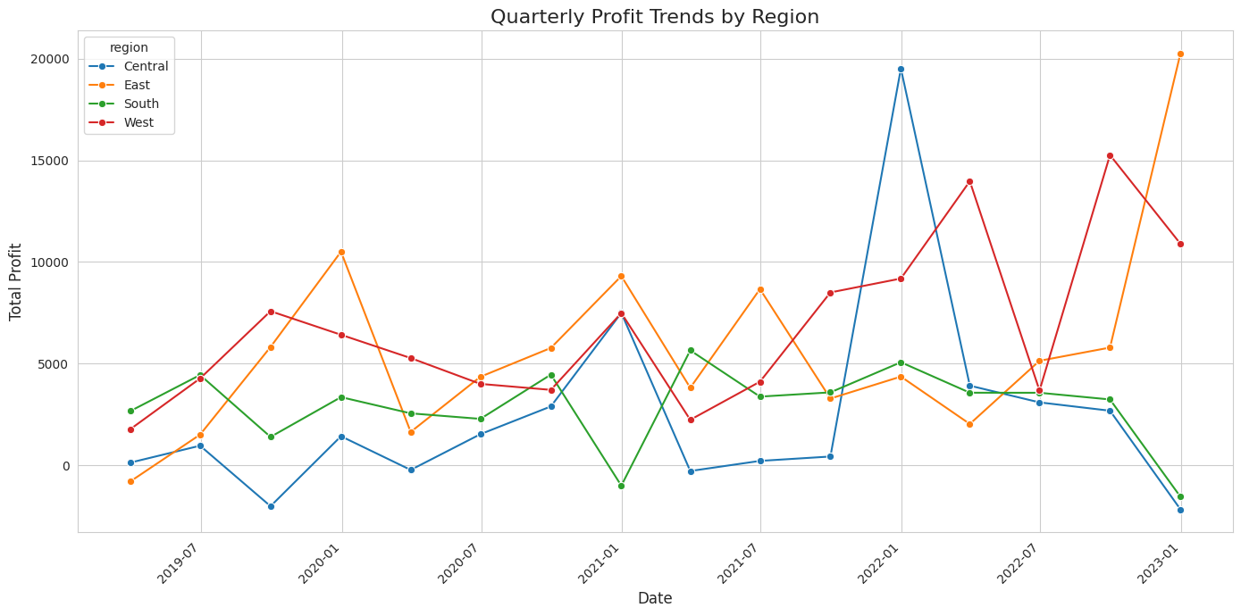
Regional/Operational Analyst
Kyasha Williams
Expansion and Consolidation
Notes:
Synthesis of Performance by Location, Operational Success, and Expansion/Consolidation
Based on the comprehensive analysis of the Superstore dataset focusing on regional performance, operational factors, and market opportunities, we can now synthesize the findings to answer the key focus questions:
How does performance vary by location?
Performance varies significantly by location, both at the regional and state levels:
Regional Variation: The West and East regions are the top performers in terms of both total sales and total profit. The South and Central regions lag behind, with the Central region having the lowest total profit. This indicates a strong geographic disparity in overall business success.
State-Level Variation: Within regions, there is also considerable variation in performance. Some states within the South and Central regions show positive profit margins and decent sales, suggesting pockets of opportunity even within lower-performing regions. Conversely, some states in otherwise high-performing regions might have lower profitability, possibly due to localized factors.
Profitability Variation: Average profit margin also varies by region, with the West having the highest average profit margin, and the Central region having a negative average profit margin. This highlights that not only sales volume but also profitability per sale differs geographically.
What operational factors impact success?
Based on the analyses performed:
Shipping Time: The direct impact of shipping time on overall profit margin and discount levels was not strongly evident in this analysis. This suggests that while shipping efficiency is important for customer satisfaction, in this dataset, it doesn't appear to be a primary direct driver of profitability or a systematic reason for applying discounts. Other operational costs (e.g., warehousing, returns, supply chain efficiency not directly measured by shipping time) could still play a significant role in regional profit variations, particularly in the Central region.
Product Mix and Profitability: The profitability varies significantly by product category and sub-category. Regions or states that sell a higher proportion of high-profit-margin products (like certain Office Supplies and Technology items) are likely to have better overall profit performance. Conversely, regions with a higher proportion of sales in low-profit or negative-profit sub-categories (like some Furniture and Office Supplies) will see their overall profitability negatively impacted.
Discounting Strategies: The analysis showed a clear negative relationship between discount levels and profit margins. Regions or product categories where aggressive discounting is more prevalent will likely experience lower profitability.
Where should we expand or consolidate?
Based on the regional performance, profitability analysis, and market opportunity identification:
Expand in High-Performing Areas: Expansion efforts should prioritize the West and East regions, capitalizing on their existing strong performance. This could involve increasing market penetration, expanding product offerings in successful categories within these regions, or optimizing infrastructure to support further growth. Specific high-performing states within other regions also represent potential expansion targets.
Investigate and Improve in Lower-Performing Areas: The South and Central regions require careful investigation. Rather than immediate consolidation, the focus should be on understanding the root causes of lower sales and profitability. This involves analyzing costs, reviewing pricing and discounting strategies, evaluating the competitive landscape, and assessing the product mix in these regions.
Consider Consolidation in Specific Low-Profit Pockets: Consolidation might be considered in specific states or areas within the South and Central regions that consistently show very low sales and significant negative profit margins across multiple product categories, and where efforts to improve performance have not been successful.
Re-evaluate Low-Profit Categories/Sub-Categories: Regardless of the region, sub-categories with persistently low or negative profit margins should be re-evaluated. This could involve optimizing operations related to these products, adjusting pricing, reducing inventory, or potentially phasing them out if they are consistently unprofitable and do not serve a strategic purpose (e.g., driving traffic).
In summary, performance varies significantly by location, influenced by a combination of regional economic factors, customer demographics, product mix, and discounting strategies. While shipping time's direct impact wasn't strongly evident, other operational costs and efficiencies likely play a role in regional profitability. Strategic expansion should focus on high-performing regions and specific high-profit states, while lower-performing areas require targeted investigation and improvement before considering consolidation. Addressing low-profitability in specific product categories is also crucial for overall business success.
Synthesis of Regional Performance, Shipping Impact, and Market Opportunities
This synthesis integrates the findings from the analyses of regional performance, the impact of shipping time, and the identification of market opportunities (expansion and consolidation) in the Superstore dataset.
1. Regional Performance:
The analysis of regional sales and profit clearly shows a significant disparity in performance across the four regions. The West and East regions are the strongest performers in terms of both total sales and total profit, highlighting their crucial role in the Superstore's overall success. The South and especially the Central region lag significantly in both metrics, with the Central region exhibiting the lowest total profit. This strong geographic variation underscores the importance of tailoring strategies to specific regional markets.
2. Shipping Time and its Impact:
The investigation into the impact of shipping time on profitability and potential customer satisfaction (inferred through discounts) did not reveal a strong direct correlation in this dataset. The scatter plots showed that profit margins and discount levels are distributed across various shipping times, suggesting that while efficient shipping is important for overall operations and customer experience, the duration of shipping alone, as analyzed here, is not a primary determinant of individual transaction profitability or discount application. Other operational factors and costs within regions or related to specific products are likely more influential on profitability.
3. Market Opportunities: Expansion and Consolidation:
Based on the regional performance and profitability analysis (including insights into category performance within regions), potential areas for expansion and consolidation can be identified:
Expansion Opportunities: The strong performance in the West and East regions indicates these are prime areas for expansion, focusing on increasing market penetration and investing further in successful product categories within these regions. Additionally, identifying and targeting specific high-performing states within the South and Central regions could offer localized expansion opportunities.
Consolidation or Improvement Areas: The lower performance in the South and Central regions, particularly the Central region's low profit, suggests these areas require careful evaluation. Rather than immediate consolidation, the focus should be on understanding the underlying reasons for lower sales and profitability through a detailed analysis of costs, pricing, product mix, and competition within these regions. Consolidation might be a consideration for specific low-profit pockets within these regions if improvement efforts are unsuccessful. Furthermore, consistently low-profit sub-categories across all regions should be re-evaluated for potential optimization or consolidation.
Overall Conclusion:
The Superstore's performance is heavily influenced by regional factors, with the West and East regions driving the majority of sales and profit. While the direct impact of shipping duration on profitability and discounts is not clearly evident, other operational efficiencies and costs likely contribute to regional performance variations. Strategic decisions regarding expansion should prioritize high-performing regions, while lower-performing areas require thorough investigation and targeted improvement strategies before considering consolidation. Addressing the profitability of specific product categories and sub-categories, especially those with negative margins, is crucial across all locations.

Slide 16

Product Performance Analyst
James Fazecas
Focus Questions:
Which products/categories perform best?
What drives product profitability?
Where should we focus product strategy?
Analysis:
Product profitability analysis
Category performance comparison
Discount impact on product success

Slide 17
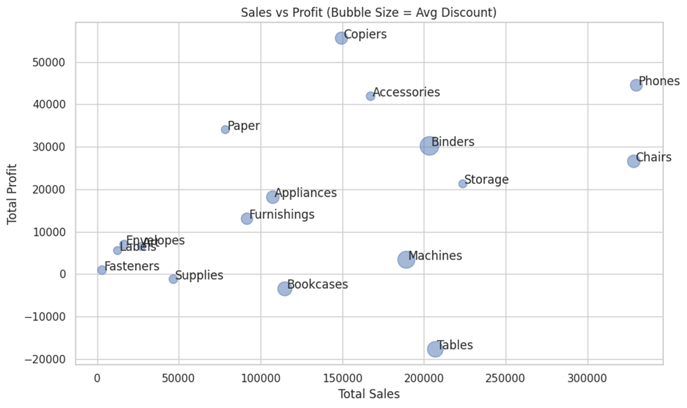
Sales vs Profit (Bubble = Discount)

Slide 18
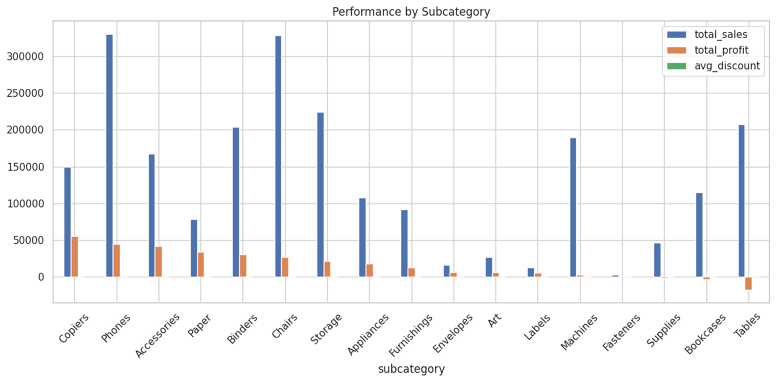
Performance Summary by Subcategory

Slide 19
Top Three Recommendations
1. Implement Regional Pricing Strategy
Deploy region-specific pricing models that reduce discounting in underperforming markets while maintaining competitive pricing in high-value regions. Eliminate aggressive discounting on Tables and Bookcases; instead, focus on margin preservation through value-based pricing.
2. Concentrate Investment in High-ROI Geographic Markets
Reallocate marketing budget and inventory investment to prioritize West and East regions, specifically targeting cities identified as high-impact drivers. Reduce expansion investments in Central and South regions until profitability improves.
3. Develop a Champion Customer Retention Program
Create a comprehensive retention strategy for Champion customers, including dedicated account management, priority shipping, and exclusive product access. Implement predictive analytics to identify potential Champions among Loyal Customers and Potential Loyalists.

Slide 20

Expected Impact
15% increase in Central/South margins
25% improvement in West/East market share
90% Champion customer retention rate
Eliminate negative-margin subcategories
20% improvement in overall profit margins

Slide 21
Thank You!

